Slide 1
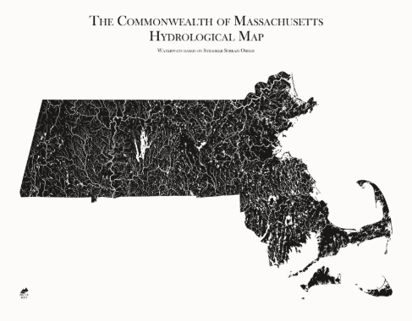
Characterizing Massachusetts Rivers & How Rain Affects Carbon Concentrations
Shannon Davis
University of Massachusetts BIOL 607
12.14.2018

Slide 2
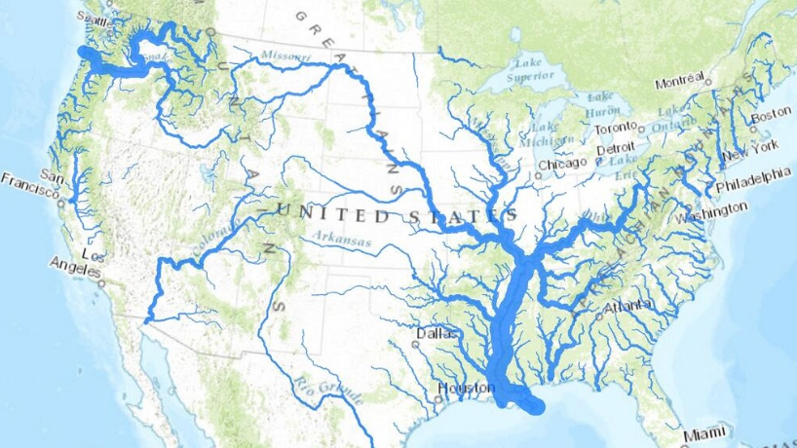
Background
Most global carbon budgets exclude small rivers
Small rivers (<10 km^3/yr) contribute approximately 57% of freshwater entering the oceans (Dai et al. 2012)
Small rivers contribute 52% of the dissolved organic carbon (DOC) to coastal areas.(Dai et al. 2012)
Discharge originating from rain events of more than 1.38 cm/day are responsible for 57% of the annual DOC flux. (Raymond and Saiers 2010)
The Boston area experiences, on average, 28 days where rainfall exceeds 1.28 cm (less than 8% of the hydrograph) (Boston Water and Sewer Commission)
Hypothesis: Flashy rivers contribute an even higher percentage of annual carbon during rain events

Slide 3
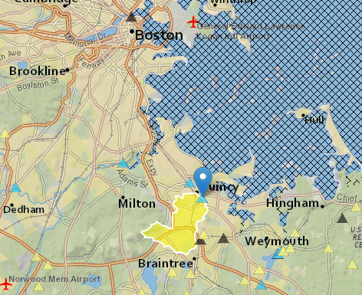
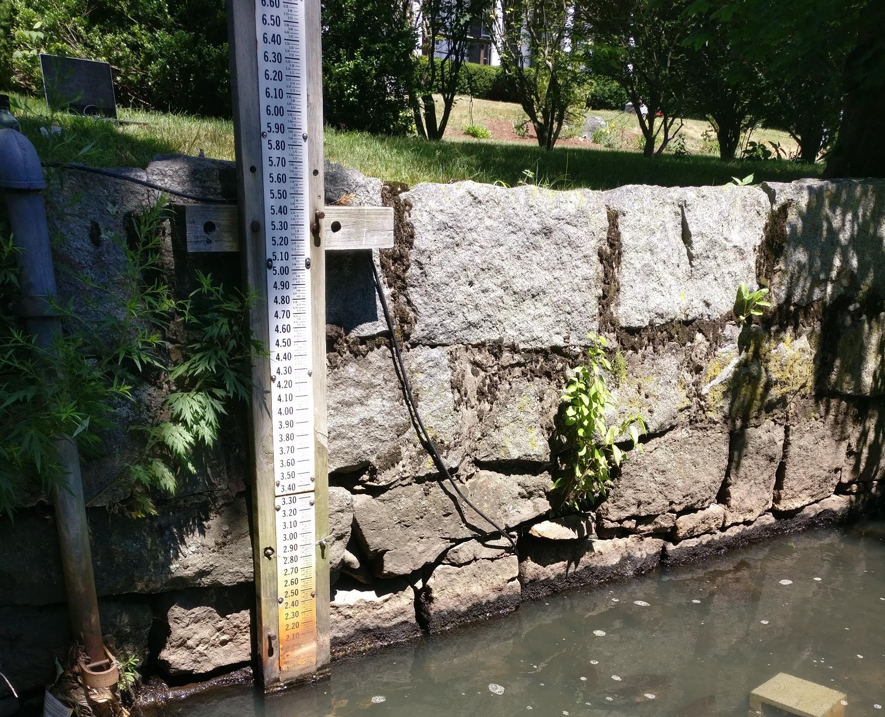
Location & Sensor
Town Brook in Quincy Massachusetts
Part of Weymouth Fore River Basin
Drainage area is 4.11 square miles
51.9% of the land is impermeable
Man made walls though most of the city
Very flashy (0.42 R-B flashness index)
Includes the downtown and many residential areas of Quincy (population of 93,000 people)
Wetlabs insitu CDOM fluorometer

Slide 4
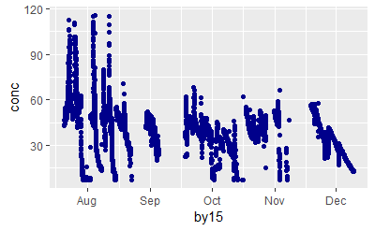
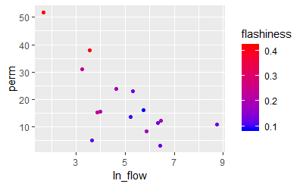
Questions
How do flow rates and percent permeability affect the flashiness of rivers?
When looking at a small flashy river how does rain affect chromophoric dissolved oxygen concentrations?

Slide 5
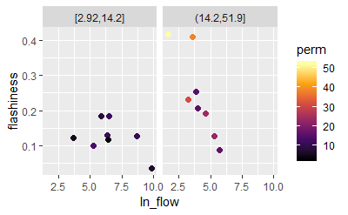
Techniques for flashiness river analysis
Multiple linear regression with interaction
Log transforming data to create linear relationship
Look at assumptions
Linearity
Normality & homoscedasticity of residuals
Outliers not influencing residuals
Minimal collinearity
Center because of high interaction
Choose best model

Slide 6

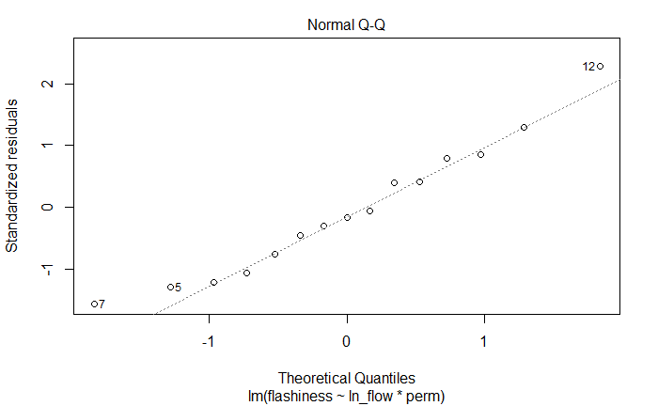
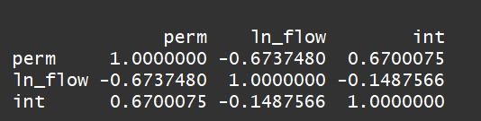
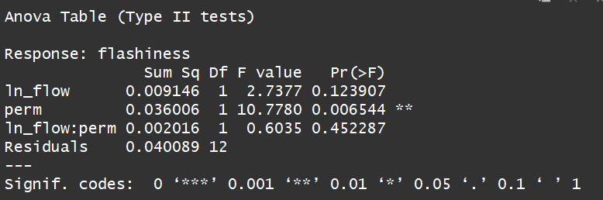
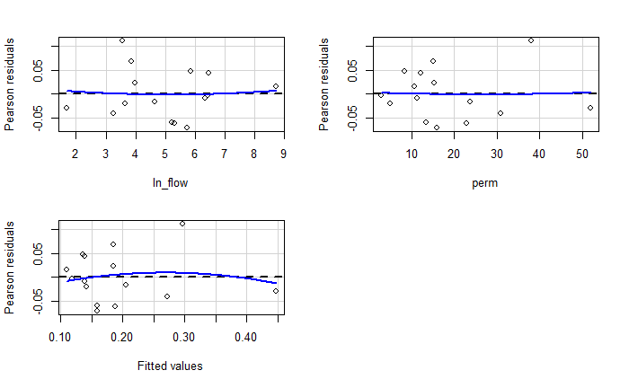
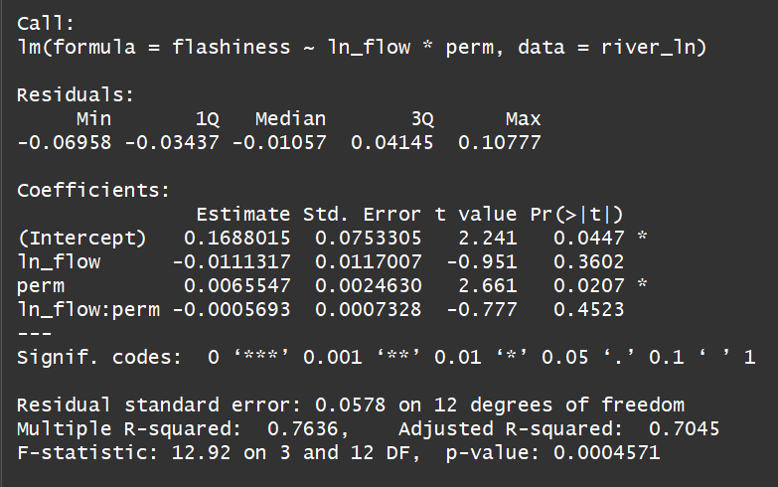

Analysis
Started out with linear model with interaction
Linearity and residuals checked out
Look at multicollinearity
Variance inflation factor is low
Correlation between parameters is high
Centered the model
Correlation stayed almost the same
Correlation table
Anova
Summary

Slide 7
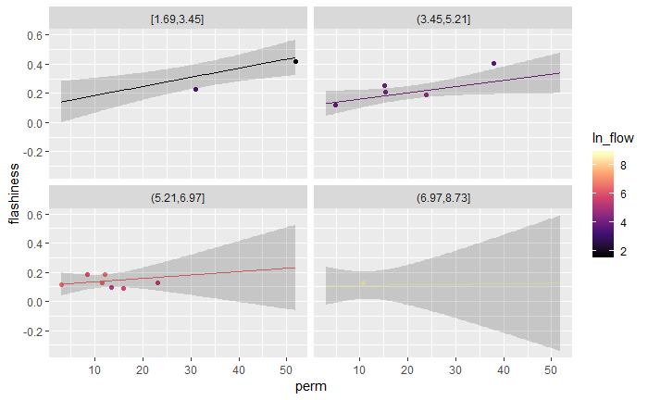
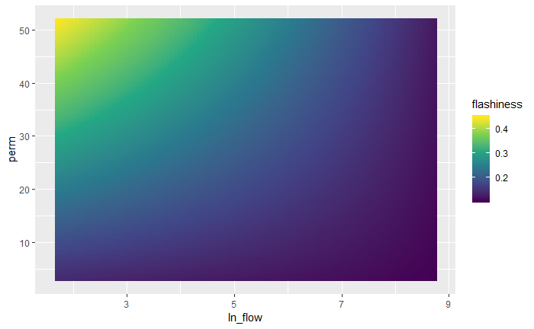
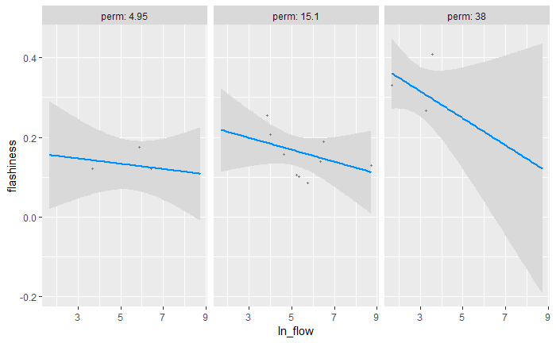
Results

Slide 8
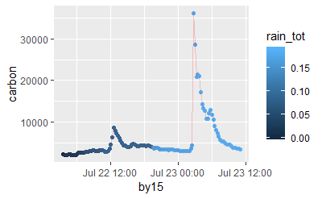
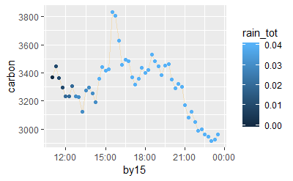
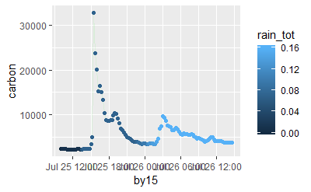
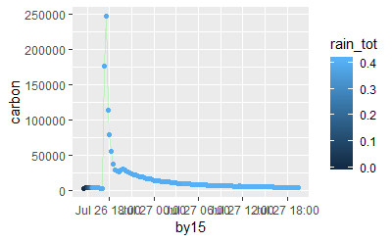
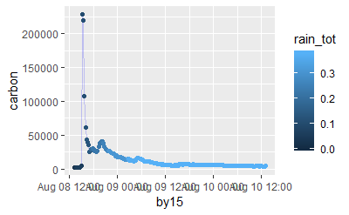
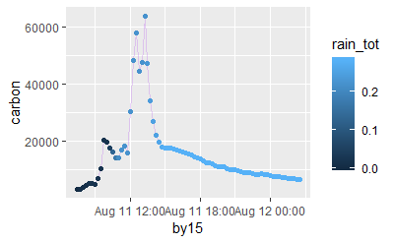
DOC during rainstorms
Different looking storms

Slide 9
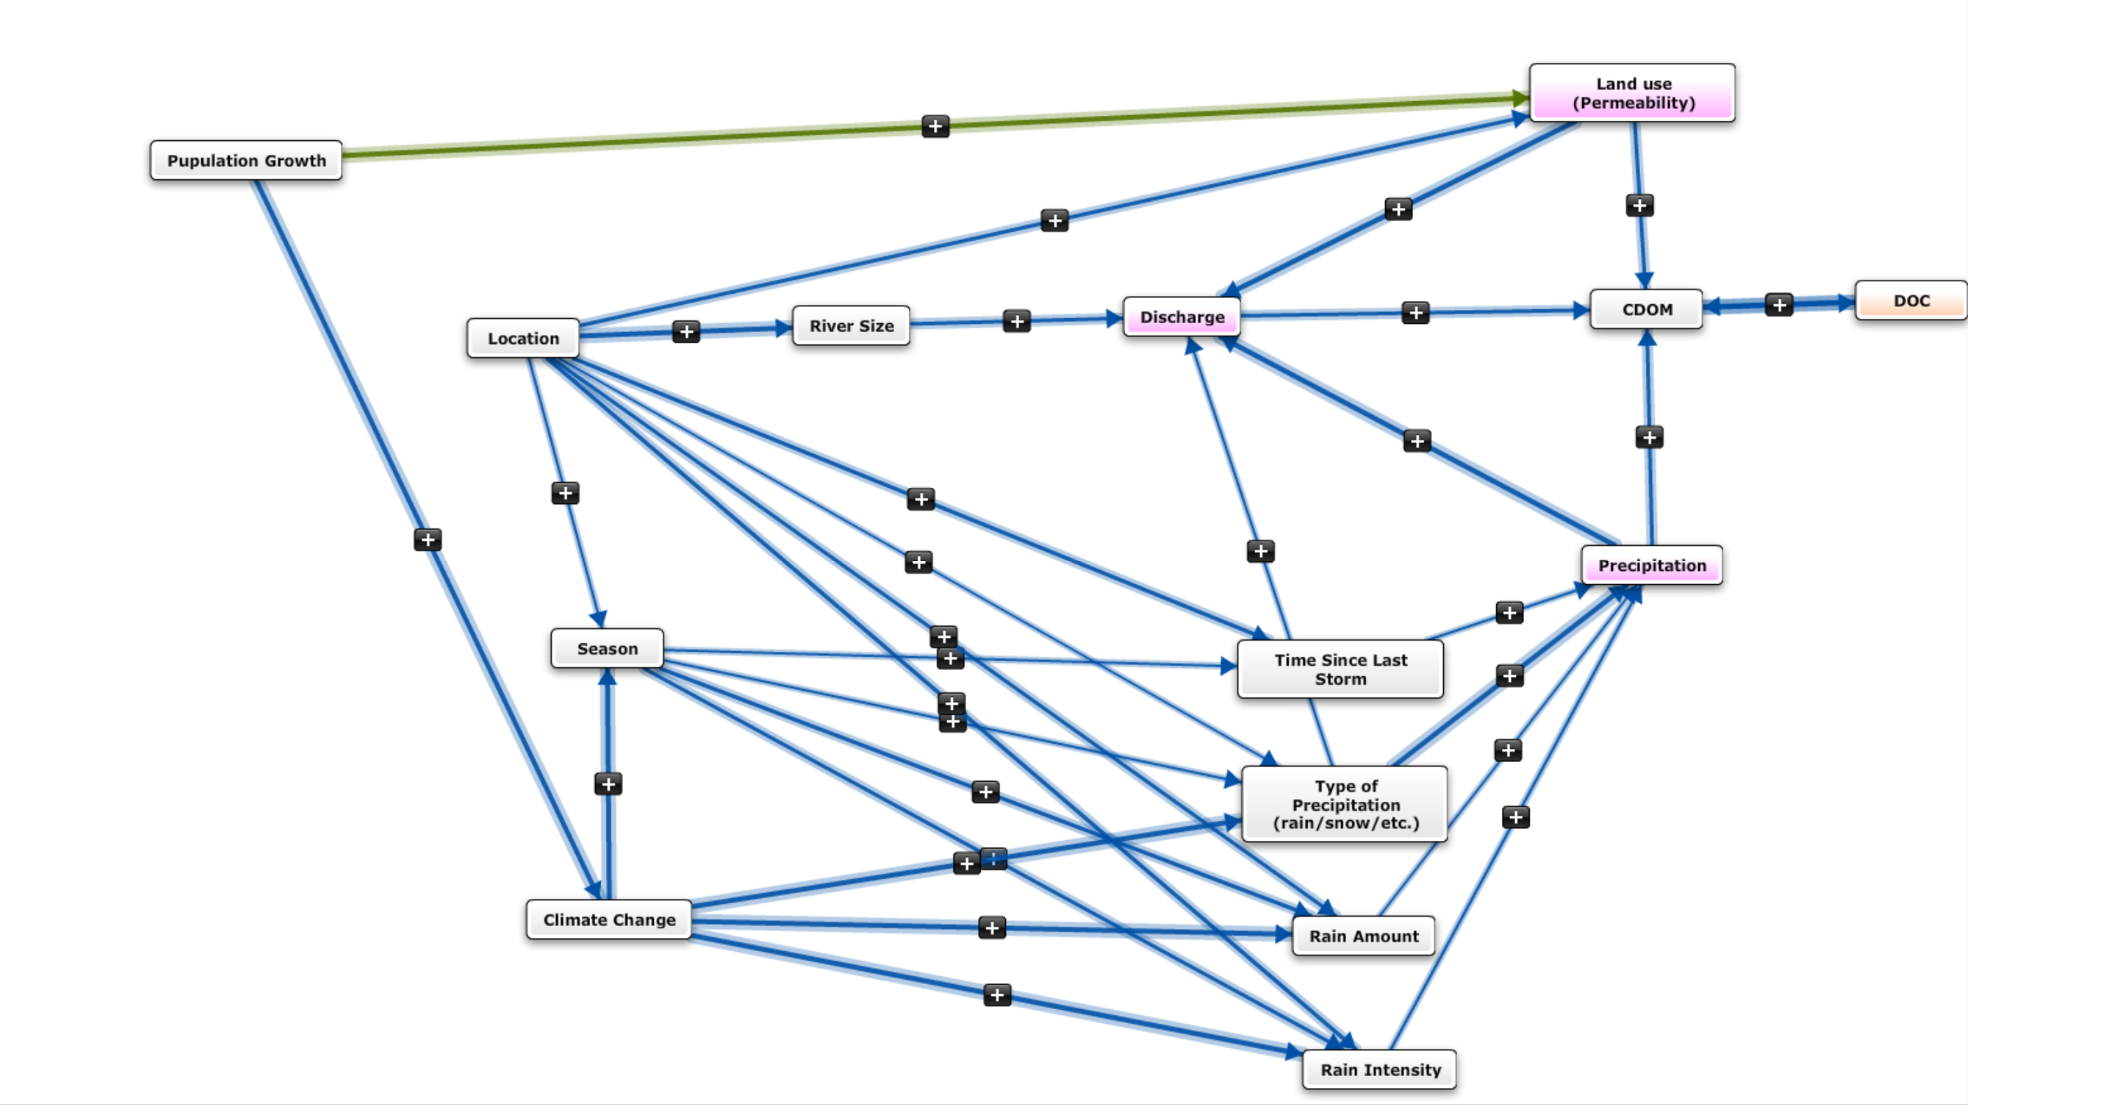
+ Ground water????

Slide 10
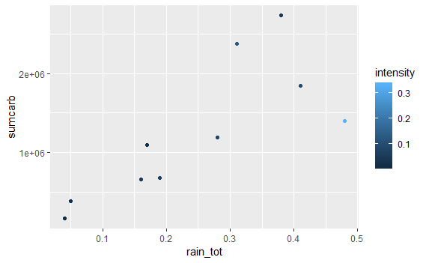
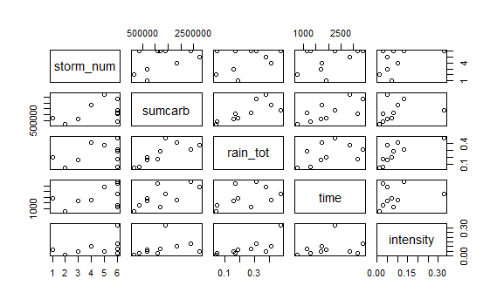
Techniques for DOC analysis
Multiple linear regression
Look at assumptions
Linearity
Normality & homoscedasticity of residuals
Minimal collinearity
Look at fit

Slide 11

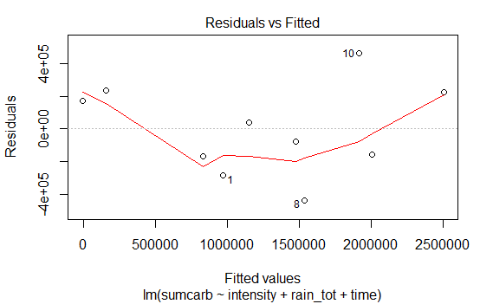
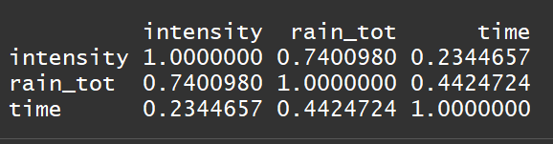
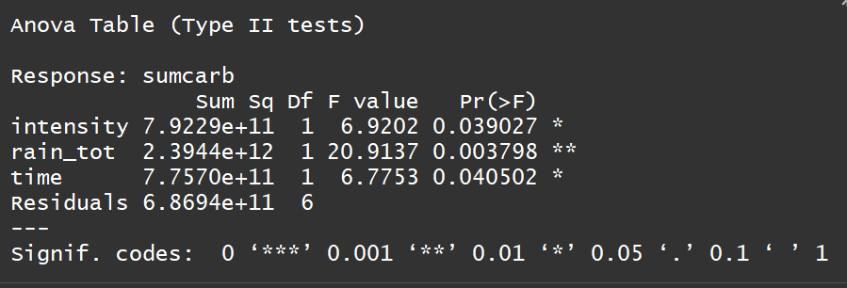
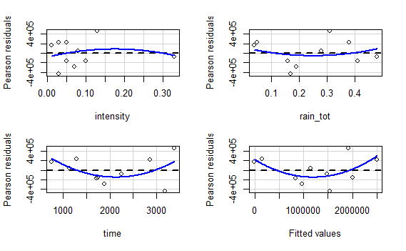
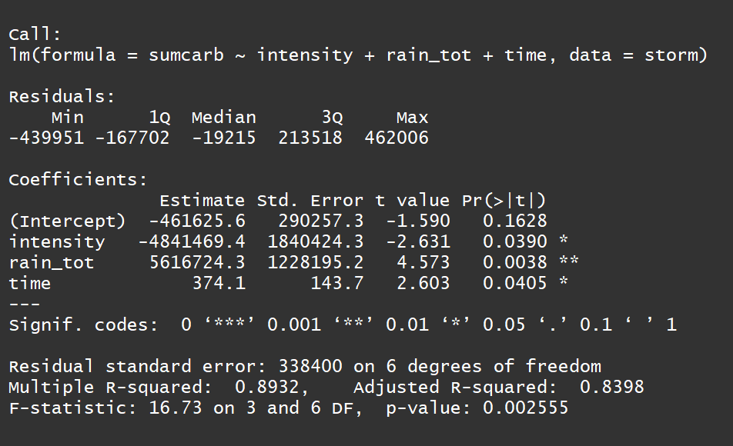
Analysis of DOC during rainstorms
Started out with linear model
Linearity and residuals checked out
Variance inflation factor is low
Correlation between parameters is high
Correlation table
Anova
Summary

Slide 12
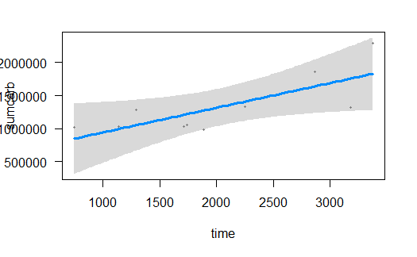
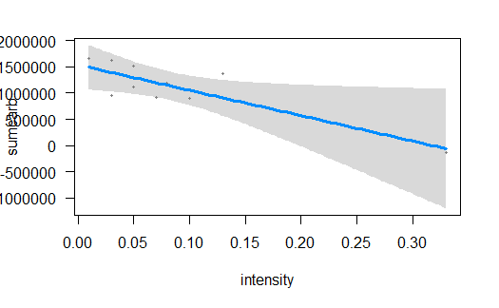
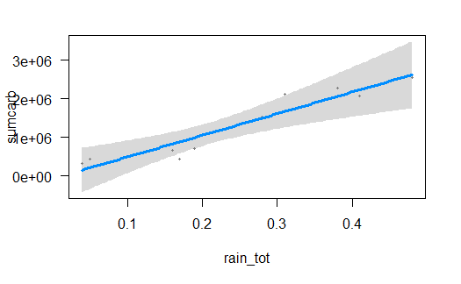
Results

Slide 13
Future work
Add many more storms
Create a method to determine length of storm
Add more rivers

